Slide 1
Information Security
Technological Security Implementation and Privacy Protection

Slide 2
Agenda
Security Theory
Administrative Security
Basic Security Technologies
Potential Attacks
HIPAA Security Rule Overview
Challenges of a Changing World

Slide 3
Information Security Theory

Slide 4
Technological Security is…
Fluid
Imperfect
Difficult
Tedious
Inconvenient

Slide 5
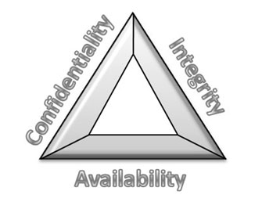
C.I.A. Triad
Basic Premise of InfoSec
Confidentiality
Secret information remains secret
Integrity
Information is not altered or destroyed
Availability
Information is not inaccessible when needed

Slide 6
Authentication vs. Authorization
Two parts of the cliché, “who are you and what are you doing here?”
Authentication
Proving Identity
Authorization
Allowing or Disallowing Actions

Slide 7
Least Privilege and Need-to-Know
Basic tenets of information or system access control
Least Privilege
Possessing the least amount of access necessary to perform job function
Need-to-Know
Access to information based only on job requirements

Slide 8
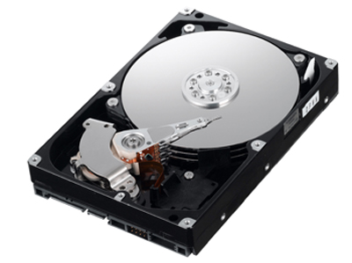
States of Data
Data in Transit
Information being transmitted between systems
Data at Rest
Information stored in any location, such as hard drive or flash drive

Slide 9
Administrative Functions of Security
Policy Implementations

Slide 10
Risk Management Program
Identify Risks
Risk to information, systems, facilities, personnel, reputation
Determine Probability of Occurrence
Determine Impact on Confidentiality, Integrity, and Availability
Accept Risk or Mitigate Risk
Document and Reevaluate

Slide 11
Security Incidents
Any occurrence with potential security impact is an incident
Malware infection, unauthorized access, data breach, and many more
Incident management plan required
From HIPAA: Breach means the acquisition, access, use, or disclosure of protected health information in a manner...which compromises the security or privacy of the protected health information.
Breach disclosure laws vary from state to state

Slide 12
Account and Access Management Policies
Documented methodology for managing access
Provisioning, altering, revoking, and reviewing access
Unique identifiers = usernames
Role-based access control
Users or systems given access based on role in an organization
Doctors have access to more health information than administrative assistants

Slide 13
Auditing and Logging
Various levels and types of logging
Recording activities, particularly security events
Monitoring logs
Identifying areas of concern

Slide 14
Basics of Security Technology

Slide 15
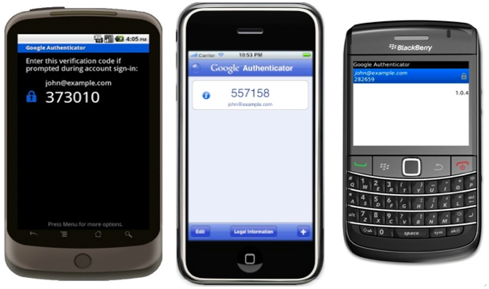
Authentication Mechanisms
Passwords
Single-use tokens
Certificates
Biometric

Slide 16
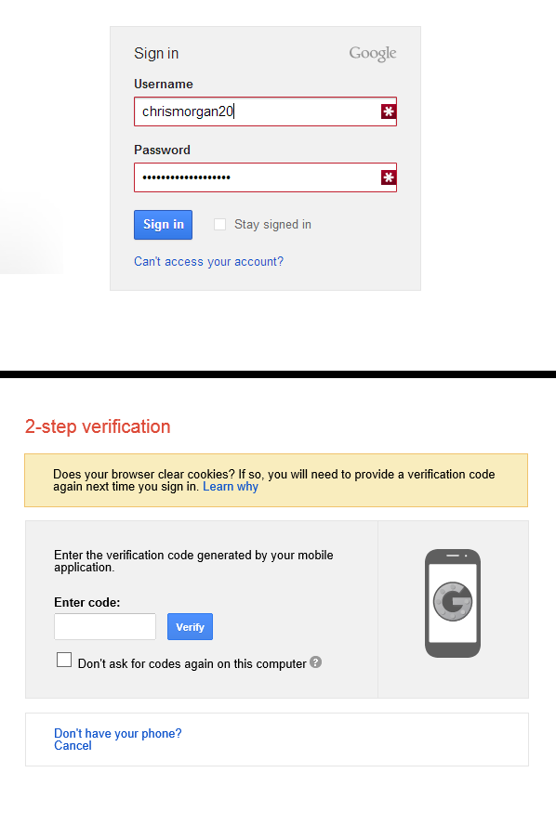
Multi-Factor Authentication
Use of multiple authentication mechanisms to establish identity

Slide 17
Encryption
Obfuscation of information
Data appears completely random while encrypted
Many different types and implementation matters
Common Uses
Securing websites through SSL/TLS: any website beginning in “https://”
Whole-Disk Encryption

Slide 18
Potential Attacks

Slide 19
Malware
Any type of malicious program
Viruses, Trojans, Adware, Spyware, and more
No anti-virus program is 100% effective
Malware is no longer destructive for the fun of it
Malware used for profit and data theft
Extensive organized crime involvement
According to the 2013 Verizon Data Breach Investigations Report, malware was involved in 40% of data breaches in 2012

Slide 20
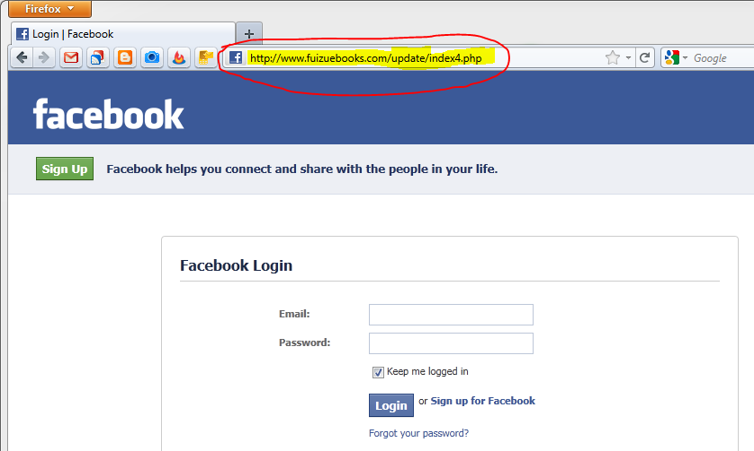
Social Engineering
Convincing a person within an organization to take a certain action
Reveal private information
Click a link
People are wired to help each other
Phishing and Spear-Phishing

Slide 21
Vulnerability of Media and Mobile Devices
Any method of transporting information represents risk
Mobile Devices (Smartphones, Tablets, Laptops)
Access to organization’s network
Contain sensitive information
Convenient but dangerous
Media (CDs, DVDs, USB Flash Drives, etc.)
All types of information can be carelessly stored on media
Easy to lose

Slide 22
HIPAA Security Rule Overview

Slide 23
Administrative Safeguards
Access establishment and modification process
Process for establishing, documenting, modifying, and reviewing access
Security Awareness and Training Program
Protection from Malicious software
Log-in monitoring -- reporting discrepancies
Password management policy
Setting, changing passwords and password requirements
Security Incident Management procedures

Slide 24
Contingency Planning
Data backup
Disaster recovery
Emergency mode operation
Procedure for continuous operation despite adverse conditions
Testing and evaluating plan
Determine criticality of systems for contingency operations

Slide 25
Technical Safeguards
Access Control and Emergency Access Procedure
Automatic Logoff
Encryption/Decryption of ePHI
Audit Controls
Integrity Controls
Method of authenticating information
Person or entity Authentication
Transmission Security Controls
Integrity Controls
Encryption

Slide 26
Challenges of a Changing World

Slide 27
Looking Ahead
Cloud Computing and Cloud Storage
Mobile Malware
Moving Beyond Anti-Virus
Bring Your Own Device

Slide 28
Christopher J. Morgan
chris@chrismorgan.cc

